Slide 1


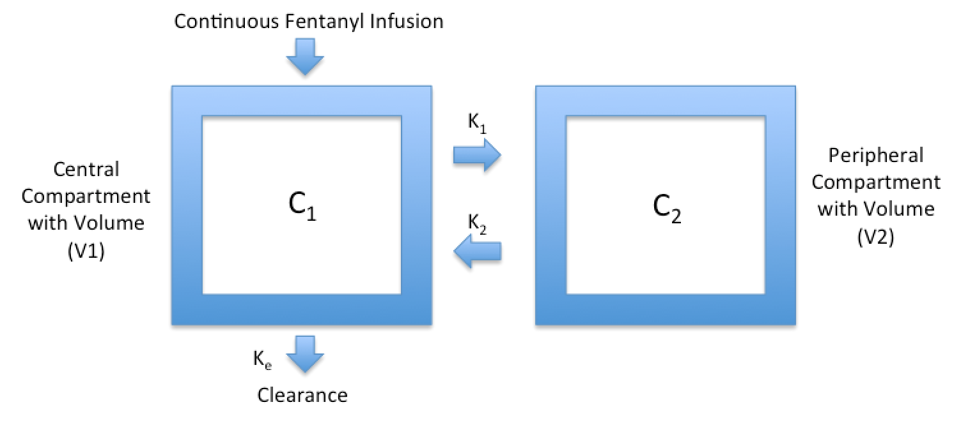
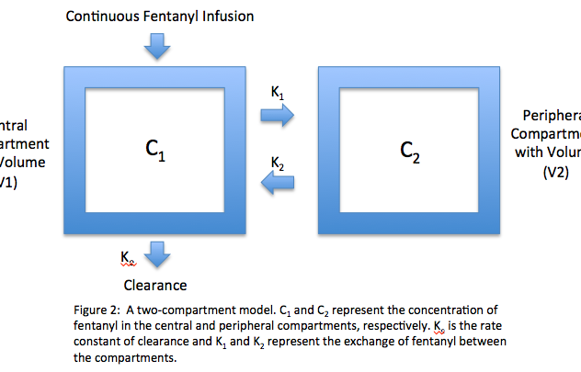
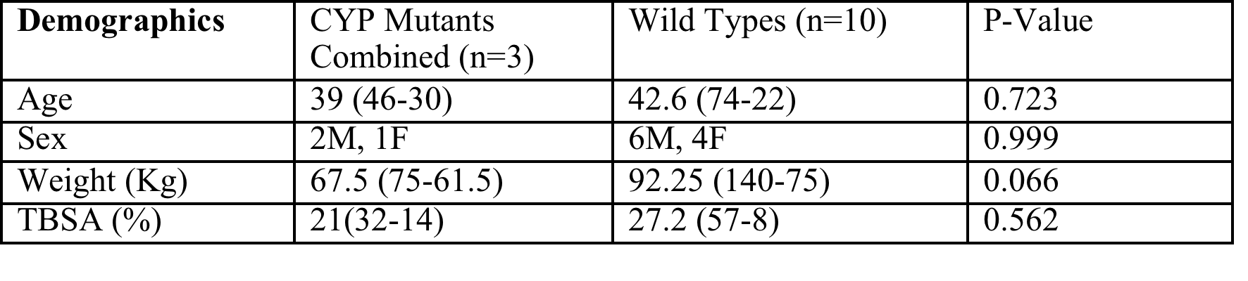
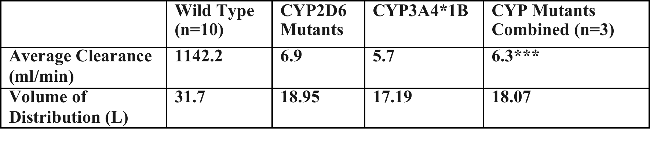
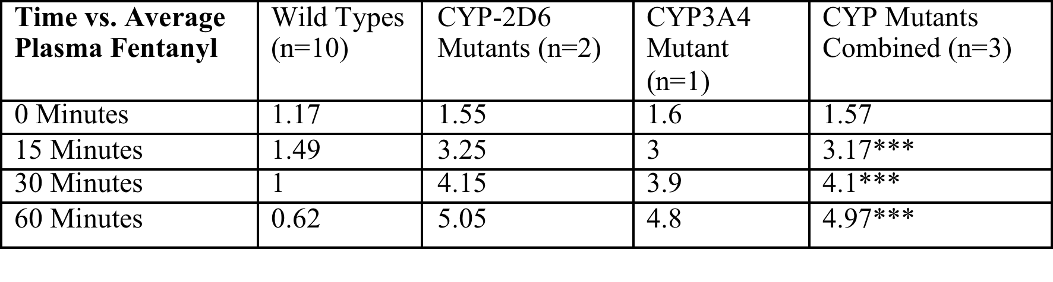
Impact of CYP Polymorphisms on Fentanyl Pharmacokinetics in Burn Patients
Paul Miller, BS¹; Xenia Ivanova¹; Kevin Bailey, MD²; Catherine Sherwin, PhD³; Nam Tran PhD, MS, FACB¹
¹Dept. of Pathology and Laboratory Medicine, UC Davis; ²Division of Burn Surgery, University of Cincinnati; ³Department of Pediatrics, University of Utah
Introduction
Methods
Figure 2: Fentanyl Concentration Over Time
Table 3: Clearance and Volume of Distribution
Pain management with opioids is a critical and challenging component of burn care. It has been shown that optimizing pain control in burn patients not only reduces acute suffering but also improves important long-term clinical outcomes^{1,2}
One of the primary opioids used in the treatment of burn patients is fentanyl. In burn patients, there is large clinical variability in fentanyl requirements which may, in large part, be due to a patient’s CYP genotype.
Genetic polymorphisms result in CYP mutant variants that can cause excessive, diminished, or absent metabolism. CYP polymorphisms may cause fentanyl elimination before it reaches its therapeutic target or to accumulate in the body with toxic effects.
The predominance of fentanyl’s metabolism is mediated by CYP3A4 conversion of fentanyl to norfentanyl, an inactive metabolite. CYP2D6 polymorphisms have also been shown to affect fentanyl pharmacokinetics. Therefore, it may be clinically useful to determine a patient’s CYP3A4 and CYP2D6 genotype prior to dosing fentanyl.
Our research hypothesizes that CYP3A4 and CYP2D6 polymorphisms will result in clinically relevant alterations in fentanyl pharmacokinetics. Given fentanyl’s impact on clinical outcomes in burn patients, genotyping patients prior to fentanyl administration may give clinicians useful information regarding optimal dosing.
The study cohort included 13 subjects comprised of 8 males and 5 females with TBSA of 22-74%.
CYP3A4/CYP2D6 genotyping was performed using PCR. Two of the mutations were found in CYP2D6 (*9,*26) and one in CYP3A4 (*1B).
Each patient was given a 70ug continuous infusion of fentanyl and fentanyl levels were taken at 0, 15, 30, and 60 minutes after fentanyl infusion.
A population PK model was developed using Monolix standalone version 2016R1.
A two-compartment model was sufficient to estimate clearance and volume of distribution.
*** Denotes p=<.01 for Wild type vs. CYP Mutants
Conclusions
Although we were only able to analyze 3 patients with CYP Polymorphisms, we were able to show a significant difference in mean fentanyl levels form 15 minute to 60 minutes after continuous IV fentanyl administration. Furthermore, fentanyl clearance was greatly decreased in the CYP mutants. These patients may be more susceptible to overdosing of fentanyl leading to poor outcomes.
These results suggest a need for further research on the topic.
*Error bars represent Standard Deviation (SD). CYP 3A4 represents a single patient. Therefore, no mean or SD could be calculated.
Table 2: Time vs. Plasma Fentanyl
Objective
Figure 1: A two-compartment model. C₁ and C₂ represent the concentration of fentanyl in the central and peripheral compartments, respectively. K_{e} is the rate constant of clearance and K₁ and K₂ represent the exchange of fentanyl between the compartments.
Further Research
The data presented represents a preliminary study that was performed with the goal of supporting the completion of a larger study of 50 adult burn patients at UC Davis Medical Center.
This follow-up study is currently underway and has been designed with adequate power to show statistical significance.
*** Denotes p=<.01 for Wild type vs. CYP Mutants
Results
The CYP2D6 mutant group was found to have significantly higher mean fentanyl concentrations by at 15, 30, and 60 minutes (P=<.01)
We found that the single CYP3A4 mutant patient also had a profile similar to the CYP2D6 mutants. Repeated measures analysis of variance was used to compare fentanyl concentrations between wild-type, CYP2D6 mutants, and the CYP3A4 mutant.
Central compartment clearance was greatly decreased in all CYP262/3A4 mutants
Figure 3: Pharmacokinetic Model for Fentanyl
Table 1: Demographics
Referenes
1. Brown NJ, Kimble RM, Gramotnev G, Rodger S, Cuttle L. Predictors of re-epithelialization in pediatric burn. Burns 2014;40(4):751-8.
2. Sheridan RL, Stoddard FJ, Kazis LE et al. Multi-Center Benchmarking Study. Long-term posttraumatic stress symptoms vary inversely with early opiate dosing in children recovering from serious burns: effects durable at 4 years. J Trauma Acute Care Surg 2014; 32:519-25.
3. F.O. Holley, and C. Van Steennis. Postoperative Analgesia with Fentanyl: Phamacokinetics of Constant Rate I.V. and Transdermal Delivery. Br. J. Anaesth. (1988), 60, 608-613
4. Shu-Feng Zhou, Jun-Ping Liu, and Balram Chowbay. Polymorphism of human cytochrome P450 enzymes and its clinical impact Drug Metabolism Reviews, 2009; 41(2): 89–295
5. Gourlay GK1, Kowalski SR, Plummer JL, Cousins MJ, Armstrong PJ. Fentanyl blood concentration-analgesic response relationship in the treatment of postoperative pain. Anesth Analg. 1988 Apr;67(4):329-37.
6. Shu-Biao W, Xian-Hui Y, Hong-Guang F, et al. Impact of CYP2D6 polymorphisms on postoperative fentanyl analgesia in gastric cancer patients. Genet Test Mol Biomarkers 2015;19:248-252.
7. Blanchet B, Jullien V, Vinsonneau C, Tod M. Influence of burns on pharmacokinetics and pharmacodynamics of drugs used in the care of burn patients. Clin Pharmacokinet. 2008;47(10):635-54.
8. D E Feierman and J M Lasker. Metabolism of fentanyl, a synthetic opioid analgesic, by human liver microsomes. Role of CYP3A4. Drug Metabolism and Disposition September 1996, 24 (9) 932-939
9. Wei ZhangYan-Zi ChangQuan-Cheng Kan-Rong ZhangZhi-Song LiHui LuZhong-Yu WangQin-Jun ChuJie Zhang. CYP3A4*1G genetic polymorphism influences CYP3A activity and response to fentanyl in Chinese gynecologic patients. European Journal of Clinical Pharmacology. January 2010, 66:61
Fentanyl Concentration (ng/ml)
Time

